Slide 1
Natural Language AnALYSIS OF BOWIE PERSONAS
Anton McConville
July 2017

Slide 2


Slide 3


Anton McConville
Digital Designer
IBM Cloud
Natural language analysis of Bowie personas
@antonmc
DevTeach

Slide 4

Context
Demo/Analysis
Implementation
Design
Bigger Picture
Natural language analysis of Bowie personas
@antonmc
Confoo

Slide 5
ex·pres·sion
ikˈspreSHən/
noun
1. the process of making known one's thoughts or feelings.
synonyms: utterance, uttering, voicing, pronouncement, declaration, articulation, assertion, setting forth;
Natural language analysis of Bowie personas
@antonmc
Confoo

Slide 6


ex·pres·sion
digital literacy
Analysis of
written work
Empathy for
our users
Software as
a medium of
expression
Natural language analysis of Bowie personas
@antonmc
Confoo

Slide 7


Slide 8
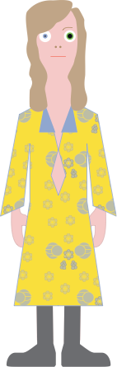
Natural language analysis of Bowie personas
@antonmc
DevTeach

Slide 9
Natural language analysis of Bowie personas
@antonmc
DevTeach

Slide 10

Natural language analysis of Bowie personas
@antonmc
DevTeach

Slide 11

Natural language analysis of Bowie personas
@antonmc
DevTeach

Slide 12

Natural language analysis of Bowie personas
@antonmc
DevTeach

Slide 13
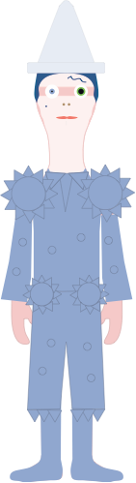
Natural language analysis of Bowie personas
@antonmc
DevTeach

Slide 14

Natural language analysis of Bowie personas
@antonmc
DevTeach

Slide 15

Natural language analysis of Bowie personas
@antonmc
DevTeach

Slide 16

Natural language analysis of Bowie personas
@antonmc
DevTeach

Slide 17



Persona
Albums
Lyrics
Watson
Personality
Insights
Natural language analysis of Bowie personas
@antonmc
DevTeach

Slide 18
Watson Personality Insights
Openness
Conscientiousness
Extraversion
Agreeableness
Neuroticism
Natural language analysis of Bowie personas
@antonmc
DevTeach

Slide 19
Thin White Duke
In later years, Bowie called the period from late 1974 until early 1977 which culminated in his Thin White Duke persona "the darkest days of my life" due to his "astronomical" cocaine usage. "I was out of my mind, totally crazed." As his drug habit ate away at his physical and mental health, Bowie attempted to reduce his cocaine intake and phase out the Thin White Duke persona, whom he had come to see as "a nasty character indeed",[12] and later, "an ogre".
Natural language analysis of Bowie personas
@antonmc
DevTeach

Slide 20
Pierrot - Scary Monsters
Natural language analysis of Bowie personas
@antonmc
DevTeach

Slide 21


Information Model
1
N
1
N
PERSONA
ALBUM
SONG
Natural language analysis of Bowie personas
@antonmc
DevTeach

Slide 22
{
"_id": "Berlin Trilogy",
"name": "Berlin Trilogy",
"location": "Berlin",
"key": "Berlin",
"style": "Industrial",
"background": "#014f83",
"start": "1976",
"end": "1979",
"sketch": "svg/berlin.svg",
"mugshot": "mug/berlin.svg",
"photo": "photo/berlin.png",
"video": "https://www.youtube.com/embed/Tgcc5V9Hu3g",
"description": "Before the end of 1976, Bowie's interest in the burgeoning German music scene, as well as his drug addiction, prompted him to move to West Berlin to clean up and revitalise his career. There he was often seen riding a bicycle between his apartment on Hauptstraße in Schöneberg and Hansa Tonstudi",
"albums": [{
"_id": "Low",
"title": "Low",
"wikipedia": "https://en.wikipedia.org/wiki/Low_(David_Bowie_album)",
"applemusic": "",
"cover": "images/covers/low.jpg"
}, {
"_id": "Heros",
"title": "Heros",
"wikipedia": "https://en.wikipedia.org/wiki/%22Heroes%22_(David_Bowie_album)",
"applemusic": "",
"cover": "images/covers/heroes.jpg"
}, {
"_id": "Lodger",
"title": "Lodger",
"wikipedia": "https://en.wikipedia.org/wiki/Lodger_(album)",
"applemusic": "",
"cover": "images/covers/lodger.jpg"
}]
},
Natural language analysis of Bowie personas
@antonmc
DevTeach

Slide 23
Browser
Python Runtime
Cloud Foundry
Blue mix
Watson
Personality
Insights
API
Cloudant
Database
Natural language analysis of Bowie personas
@antonmc
DevTeach

Slide 24
Browser
Python Runtime
Cloud Foundry
Blue mix
Watson
Personality
Insights
API
Cloudant
Database
Get Graph Data
Fetch Lyrics
Lyrics
Analyze
PI Data
Plot PI Data
Natural language analysis of Bowie personas
@antonmc
DevTeach

Slide 25

Watson
Personality
Insights
IBM
Blue mix
insight = personality_insights.profile(json.dumps({'text':personality, 'contenttype': 'text/html'}))
Natural language analysis of Bowie personas
@antonmc
DevTeach

Slide 26
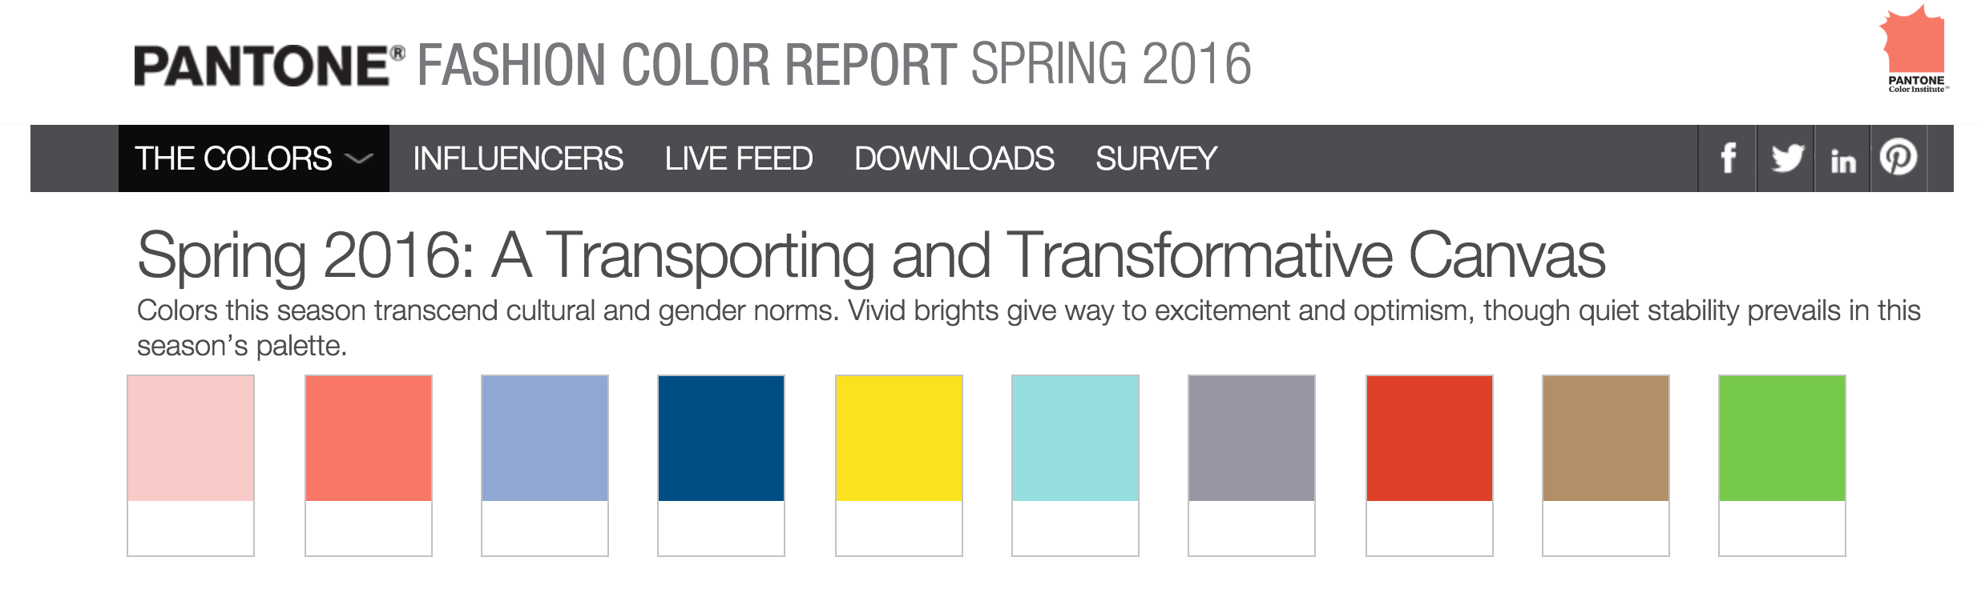
Natural language analysis of Bowie personas
@antonmc
DevTeach

Slide 27
display:flex;
F
L
E
X
FLEX CONTAINER
FLEX ITEMS
Natural language analysis of Bowie personas
@antonmc
DevTeach

Slide 28
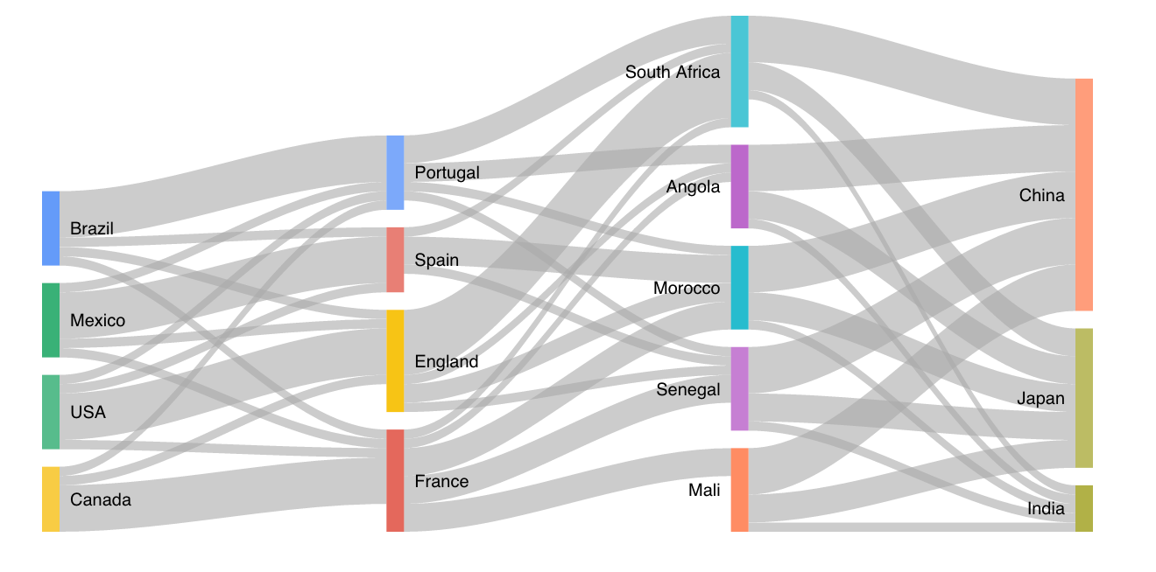
Natural language analysis of Bowie personas
@antonmc
DevTeach

Slide 29
Hyper-Personalization
Natural language analysis of Bowie personas
@antonmc
DevTeach

Slide 30
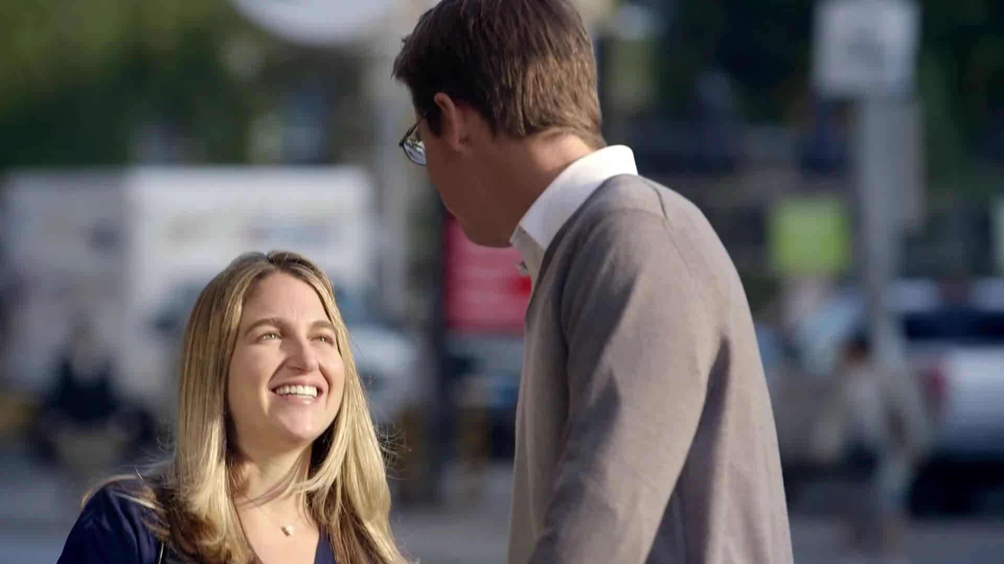

Slide 31
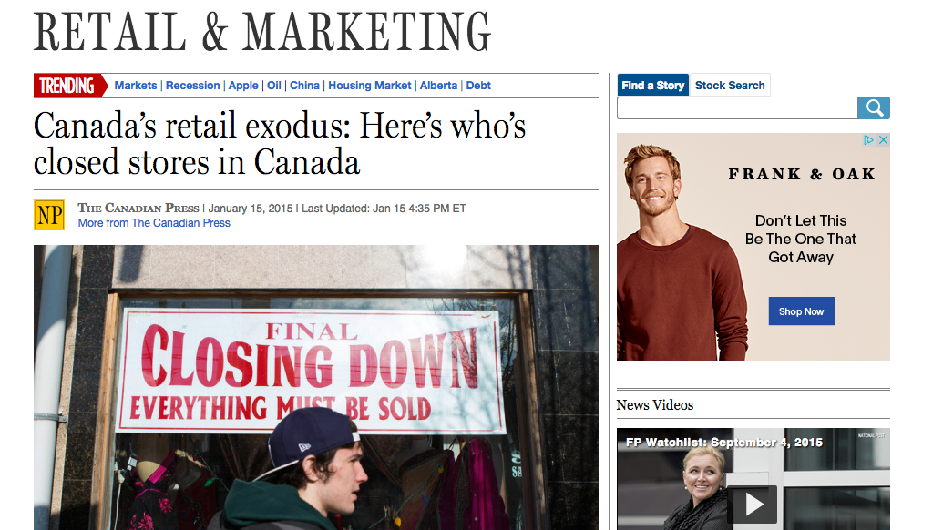

Slide 32

First questions they ask are about your tastes, your dimensions

Slide 33

Targeting Personality
Natural language analysis of Bowie personas
@antonmc
DevTeach

Slide 34
Real Time Tone
Natural language analysis of Bowie personas
@antonmc
DevTeach

Slide 35
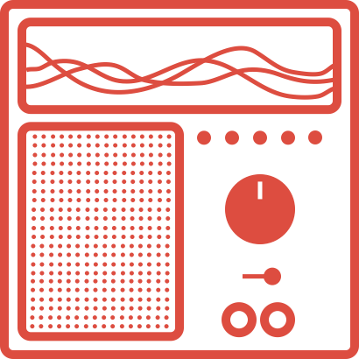
Natural language analysis of Bowie personas
@antonmc
DevTeach

Slide 36
“Tomorrow belongs to those who can hear it coming”.
– David Bowie
Natural language analysis of Bowie personas
@antonmc
DevTeach

Slide 37

bluemix.net
`
ziggy.mybluemix.net
https://github.com/IBM-Bluemix/ziggy
@antonmc
Natural language analysis of Bowie personas
@antonmc
DevTeach

